Slide 1
CLASS ATTENDANCE SYSTEM
Author: Mushindi Rachel

Slide 2
Introduction
The class attendance system uses QR code to take and record student`s attendance.
The system is integrated in the student’s university portal, where every student will be required to login into their portals and scan the QR code provided by their lecturers for every class. This applies for the units they have registered for.
Wei Ha, Liping Ma, Yulian Cao, Qinxue Feng and Shangcong Bu state that, For one standard deviation increase in class attendance, increases academic performance by 0.08 standard deviation.

Slide 3
Background Problem
Taking attendance is one of the day-to-day activity carried out in Kenyan universities, but there has been a major concern on doing it efficiently and accurately.
Most students will skip classes and ask their friends to sign the attendance sheet on their behalf, this has made some lectures to be calling out the attendance register name by name in order to maintain quality in taking class attendance. Come think of it, this is time consuming and tiresome.
Attendance sheets has also become a workload to lecturers, whereby they have to do analysis at the end of the semester, so as to ensure students have attained the 80% minimum requirement for them to sit for their end of semester exams.

Slide 4

Problem solved?
Technology has evolved and there is a solution for every problem. Therefore coming up with a web-based class attendance system using QR is a solution for the problem.
In as much as there is an option of using biometrics which can be expensive to implement, this solution also considers the universities that are still growing.
The solution aims to eradicate paper work and increase the quality in taking class attendance.

Slide 5
Advantages of the system
Improved quality
Less paper work
Real-time analysis
Time saving
Data security
Cost-effective

Slide 6
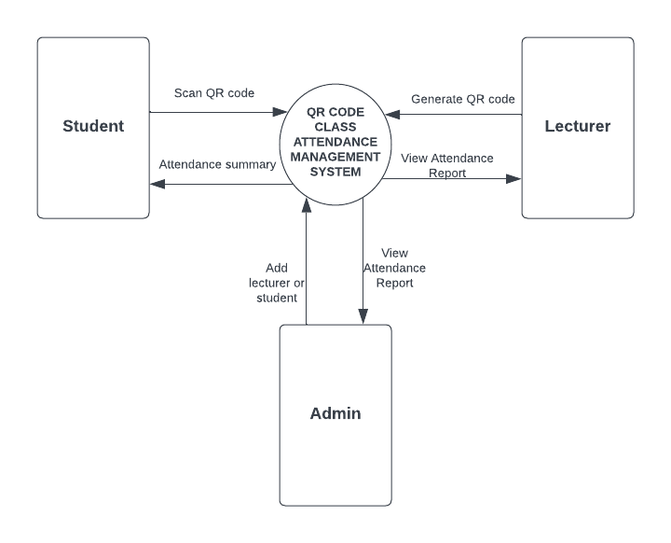
The System

Slide 7
System Development
The class management system is developed using:
HTML- Used for structuring the web pages.
CSS- Utilized styling and layout design
JavaScript- Implemented for client-side interactivity and dynamic behavior.
Django- A python framework.
SQLite3- Selected as the database management system for its flexibility in handling data.

Slide 8
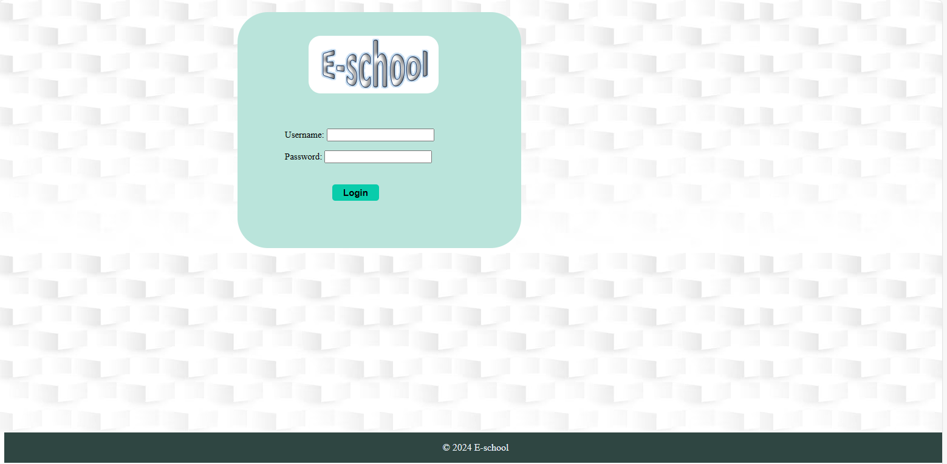
A Tour through the system…
Login Module:

Slide 9
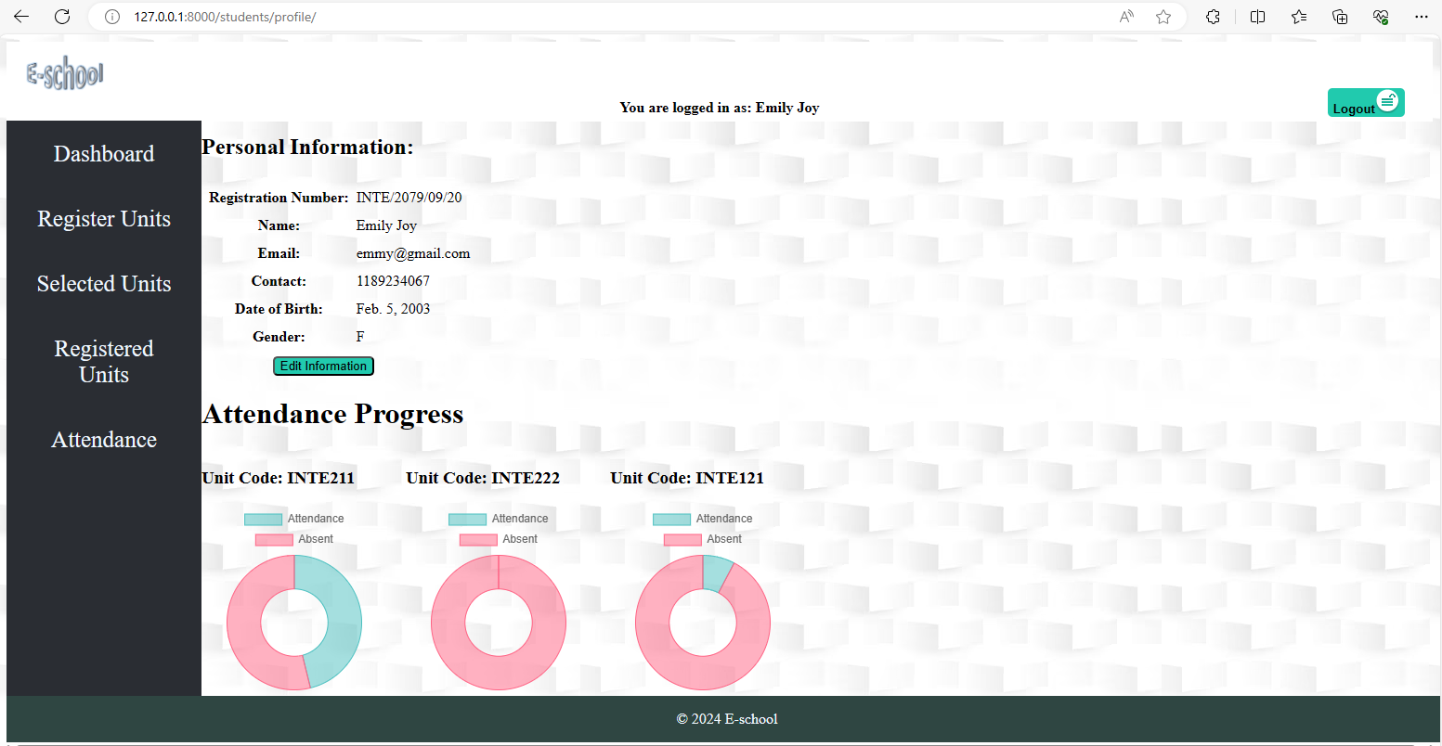
A Tour through the system…
Student Dashboard:

Slide 10
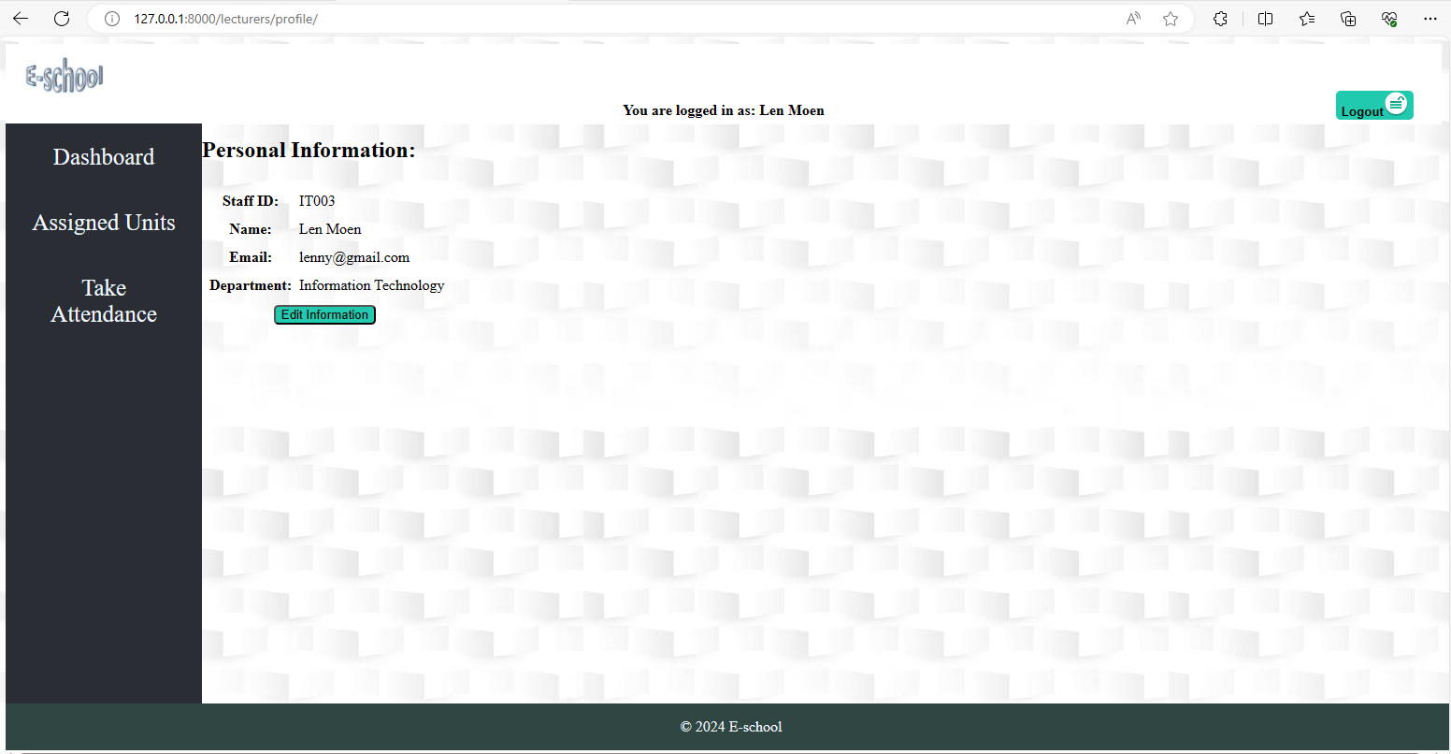
A Tour through the system…
Lecturer’s Dashboard:

Slide 11
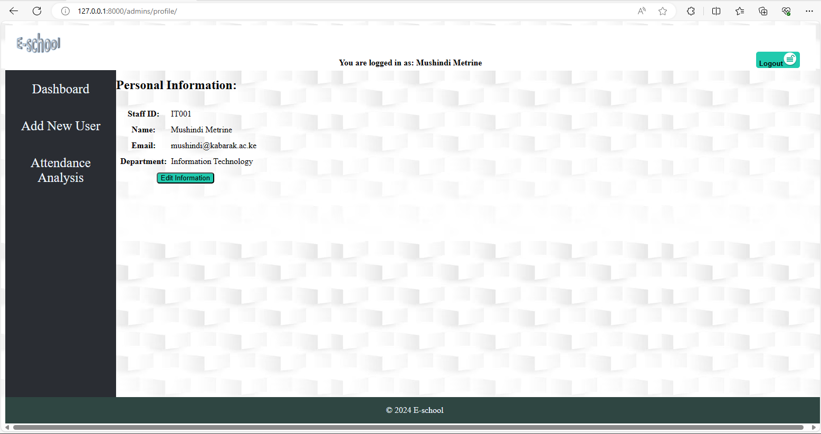
A Tour through the system…
Admin Dashboard:

Slide 12
Demo: http://127.0.0.1:8000/
Thank You

